Slide 1

Li-Chi
Boba Shop Case Study
Ann Jessica Tan

Slide 2
Prompt
“You are the business analyst on the Strategy and Operations team for the Li-Chi Boba Shop Company. The company has physical boba shops in three cities in California, and customers place their orders via the app and pick up the orders in person.
The objective of Li-Chi Boba Shop this year is to grow total sales revenue (please note that menu prices for the year have been set already). Based on the one week app data attached, please present your findings and provide a set of recommendations for growing total sales revenue. Feel free to make your own assumptions.”

Slide 3
Agenda Slide
Analysis Approach/Framework
Business Opportunity 1: Increase Customers
Business Opportunity 2: Increase Order Frequency
Business Opportunity 3: Increase Order Size
Key Recommendations Slide
Q&A

Slide 4

Analysis Approach/Framework
Objective: Increase Li-Chi Boba Shop’s total sales revenue (menu prices for the year have been set already)
Sales
Revenue ($)
=
# of Units Sold
x
Avg. Selling Price
As menu prices for the year have already been set, we can’t increase the selling price
Business Opportunities
1. Increase customers (acquire new customers + retain existing customers)
2. Increase order frequency (more orders per person per week)
3. Increase order size (more drinks per order)

Slide 5
1. Increase Customers
(acquisition + retention)

Slide 6
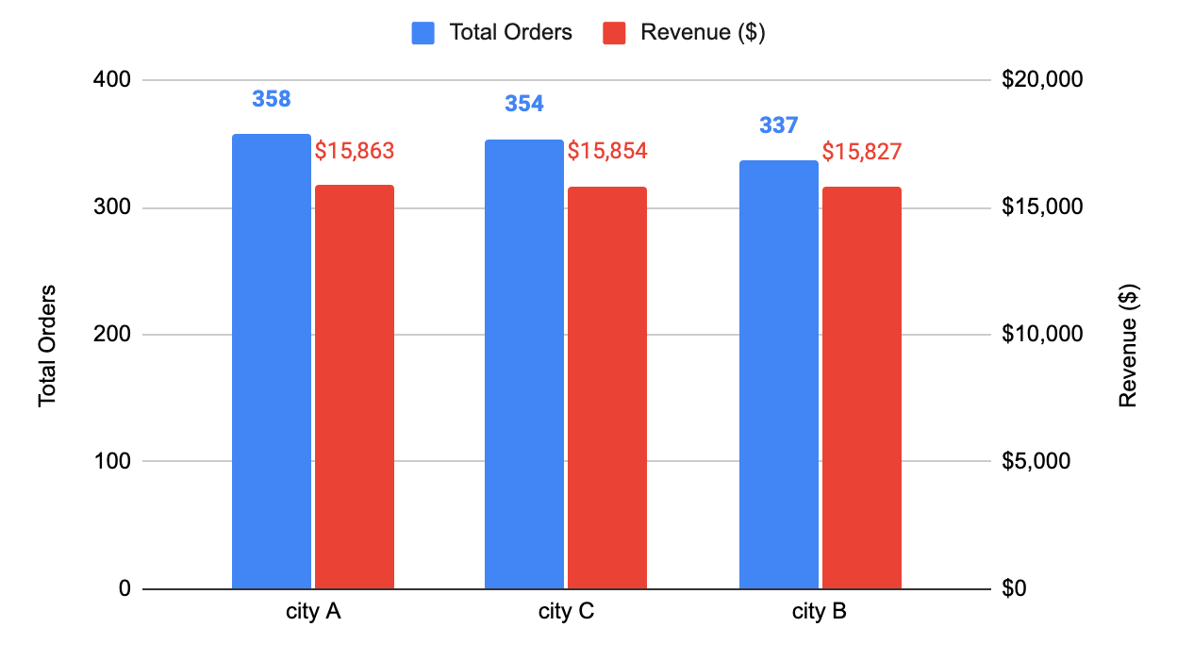
Increase marketing/advertising effort to acquire new users in City A given its high orders and revenue.
Total Orders and Revenue by City
City A has the highest total orders and revenue at 358 and $15K, respectively, followed by City C (354, $15K), and City B (337, $15K)
Given that City A has the highest demand (based on total orders and revenue), we recommend capitalizing on the existing momentum by increasing marketing and advertising spend/effort in City A to acquire new users.

Slide 7
Drive traffic to store wehqk (best operational excellence) while conducting deep-dives in store acjde (worst operational excellence) to increase acquisition and retention.
Store wehqk has the best operational excellence (highest average rating, lowest refund, shortest avg. prep time), while store acjde has the worst operational excellence (lowest avg. rating, highest refund, and highest avg. prep time)
Given that store wehqk has the best operational excellence that is crucial for brand loyalty in the competitive boba shop market, we recommend driving traffic (i.e. online marketing, SEO, etc.) to store wehqk for customer acquisition and downstream customer retention.
As store acjde has the worst operational excellence, we recommend conducting deep dives into the store acjde to root cause the issue and develop strategies accordingly (i.e. staff training, equipment check ups, etc) to ensure customer retention.
Operational Excellence by Store
store id | Average Rating | Refund Total ($) | Average Order Prep Time (h:m:s)
wehqk | 3.7 | $394 | 0:11:00
bjdwe | 3.6 | $398 | 0:13:00
acjde | 3.2 | $401 | 0:14:00
Grand Total | 3.5 | $1,193.0 | 0:13:00
Best operational
excellence
Worst operational
excellence

Slide 8
2. Increase Order Frequency

Slide 9
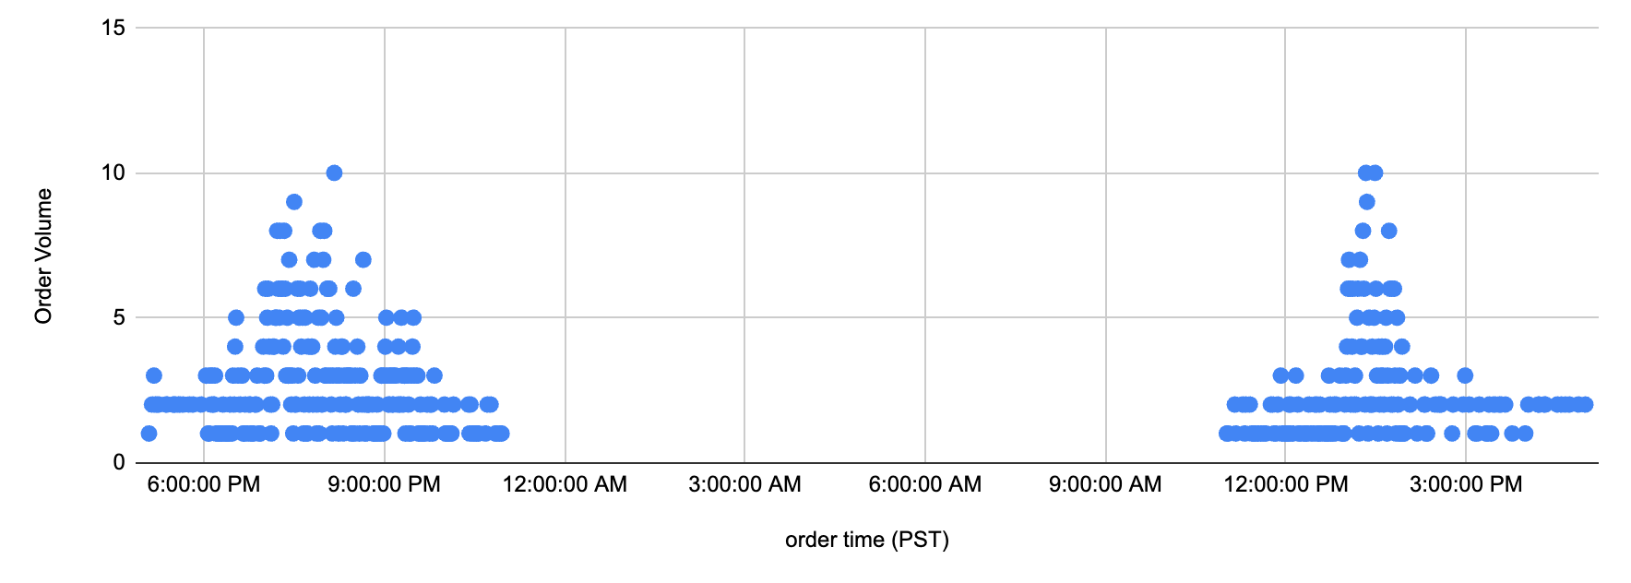
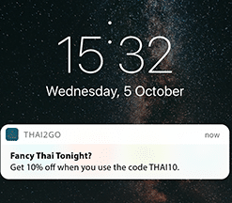
Send email/push notifications around two order peak time (6PM-10PM, 12PM-3PM) to increase order frequency.
Order Volume by Order Time
Order volume has two peaks, one from 6PM-10PM at night, and another from 12PM-3PM in the afternoon.
To capitalize on the time frame when general demand tends to be the highest, we recommend sending email/push notifications around that time to increase order volume (e.g. UberEats sending push notifications around dinner time reminding users to order food).
Peak Order Volume Time
6PM-10PM
Peak Order Volume Time
12PM-3PM
Example: UberEats push notification incentivizing dinner order before dinner time

Slide 10
3. Increase Order Size

Slide 11
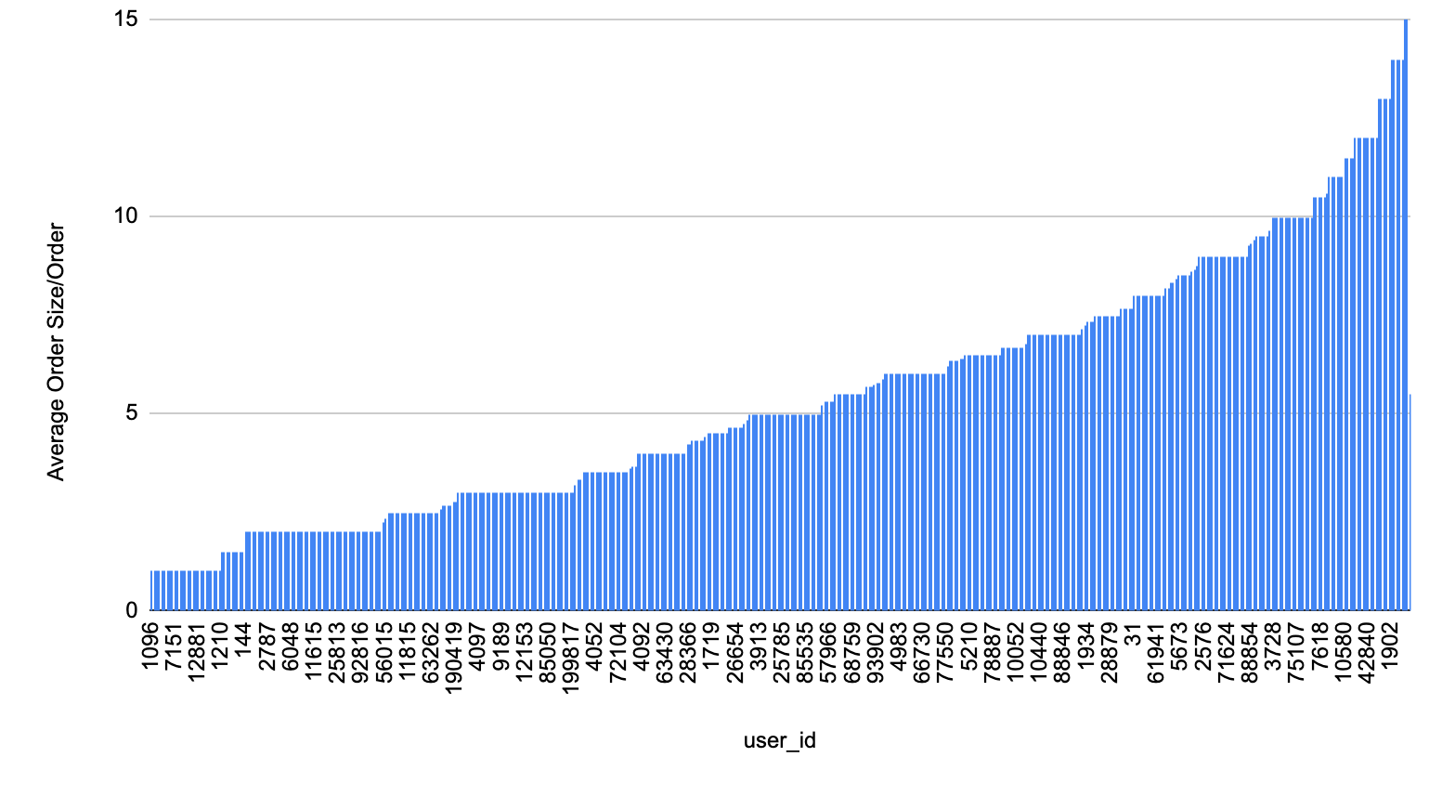
Incentivize customers (whose order size falls below 5 drinks/order) via benefits/promotions to increase the number of boba sold per order.
Customers by Average Order Size per Order
44% of users falls below the average order size of 5 drinks per order.
As almost half of the current users’ order fall below the order size average, we recommend incentivizing customers to order more drinks via benefits and promotions to increase the number of boba sold per order. (e.g. free topping when you buy more than X amount of drinks, get X drinks for $x off, etc)
Average Order Size per Order
= 5
Users who fall below the average order size/order

Slide 12
Key Recommendations
1. Increase Customers: Increase marketing/advertising effort in best performing city and store, while optimize on worst performing store to drive acquisition and retention.
Increase marketing/advertising effort in City A to acquire new users given it’s high orders and revenue.
Drive traffic to store wehqk (best operational excellence) while conducting deep-dives in store acjde (worst operational excellence) to increase acquisition and retention.
2. Increase Order Frequency: Leverage comms capabilities (email, push notifications) to increase order frequency.
Send email/push notifications around two order peak time (6PM-10PM, 12PM-3PM) to increase order frequency.
3. Increase Order Size: Test benefits/promotions to increase average order size.
Incentivize customers (whose order size falls below 5 drinks/order) via benefits/promotions to increase the number of boba sold per order.

Slide 13
Thank You!
(Q&A)

